Slide 1





USER INTERFACE PRESENTATION
Version 1.0

Slide 2

User Interface Modules
Landing page
Home page
Explore Index
State Profile
Compare States
Tools and Analyses
Downloads
Contact Us
Notes:
The primary data management contains three steps – Ingestion, Cleaning and Calculate. Let us understand about each step.

Slide 3

LANDING PAGE
Click on 'Explore’ button or either on the IEMI logo to navigate to the Home Page

Slide 4

1
Home Page

Slide 5
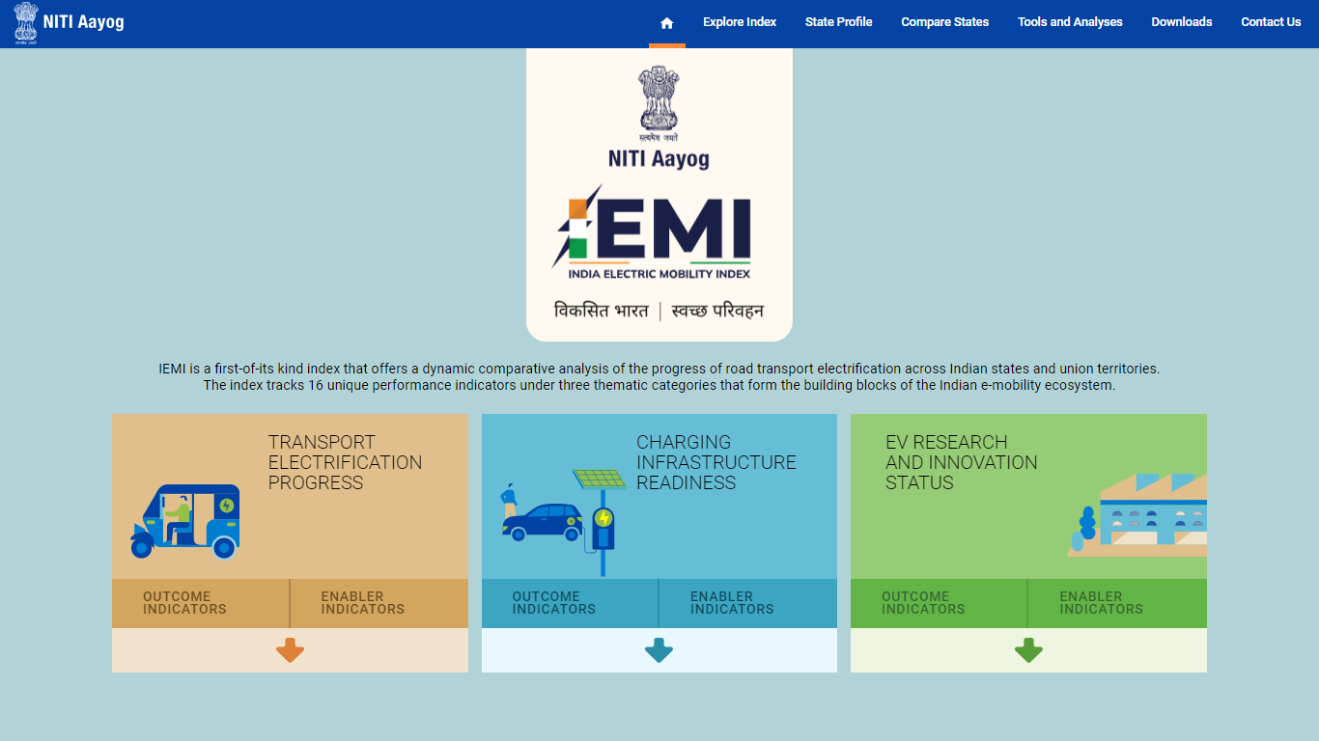
HOME PAGE
Introduction to IEMI and its three thematic categories

Slide 6
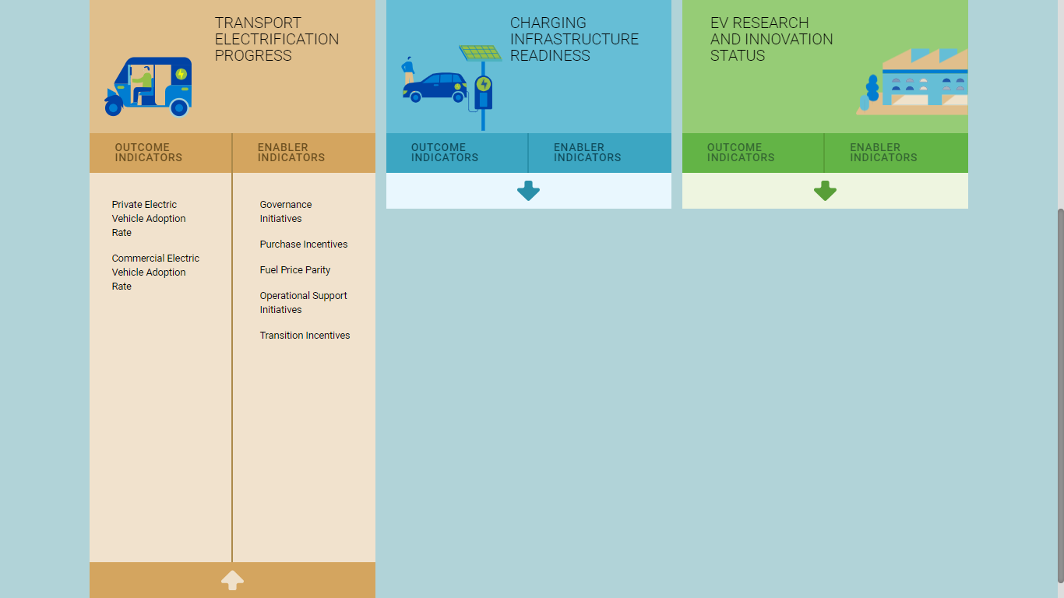

HOME PAGE
Click on the arrow icon to expand/collapse the list of Outcome and Enabler indicators of the selected theme

Slide 7
HOME PAGE
Click on the theme to navigate to the Explore Index module to view the detailed data of the selected theme

Slide 8
2
Explore Index

Slide 9
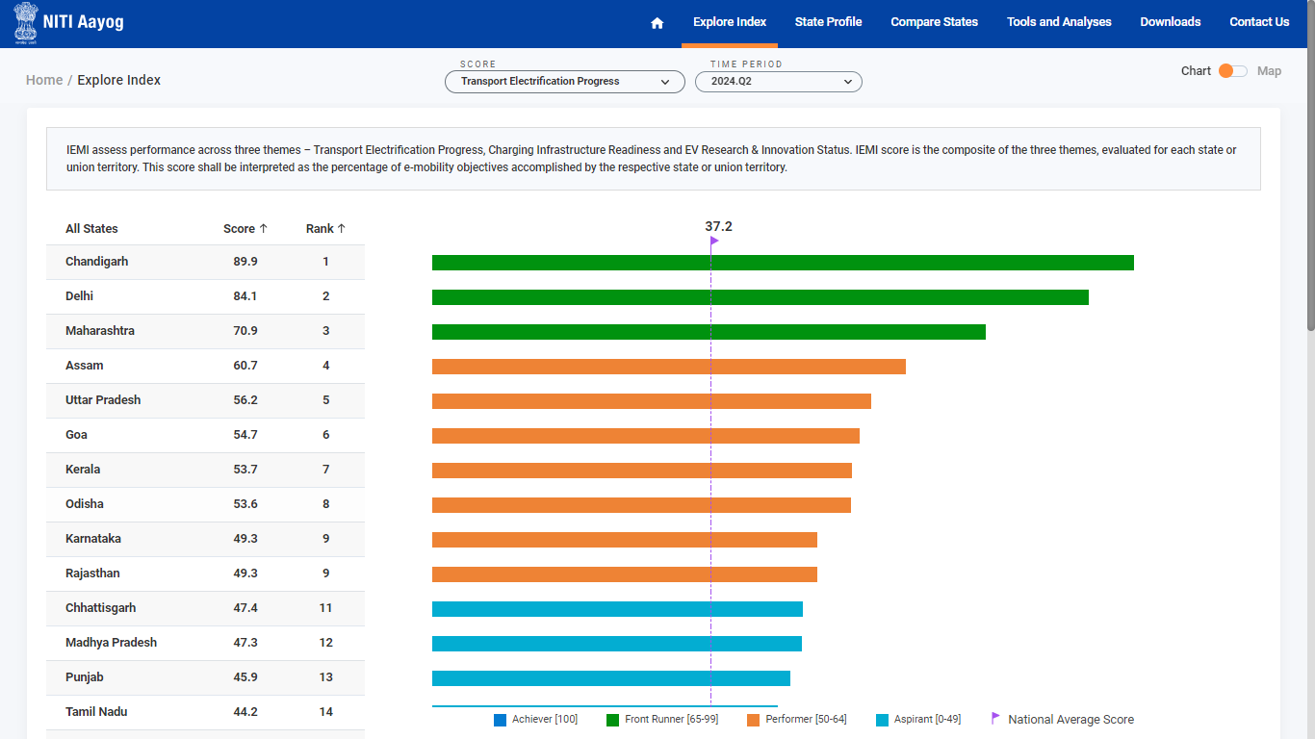
EXPLORE INDEX
View the composite Index Score of the selected theme and time period for all the states using the bar chart visuzlaition

Slide 10
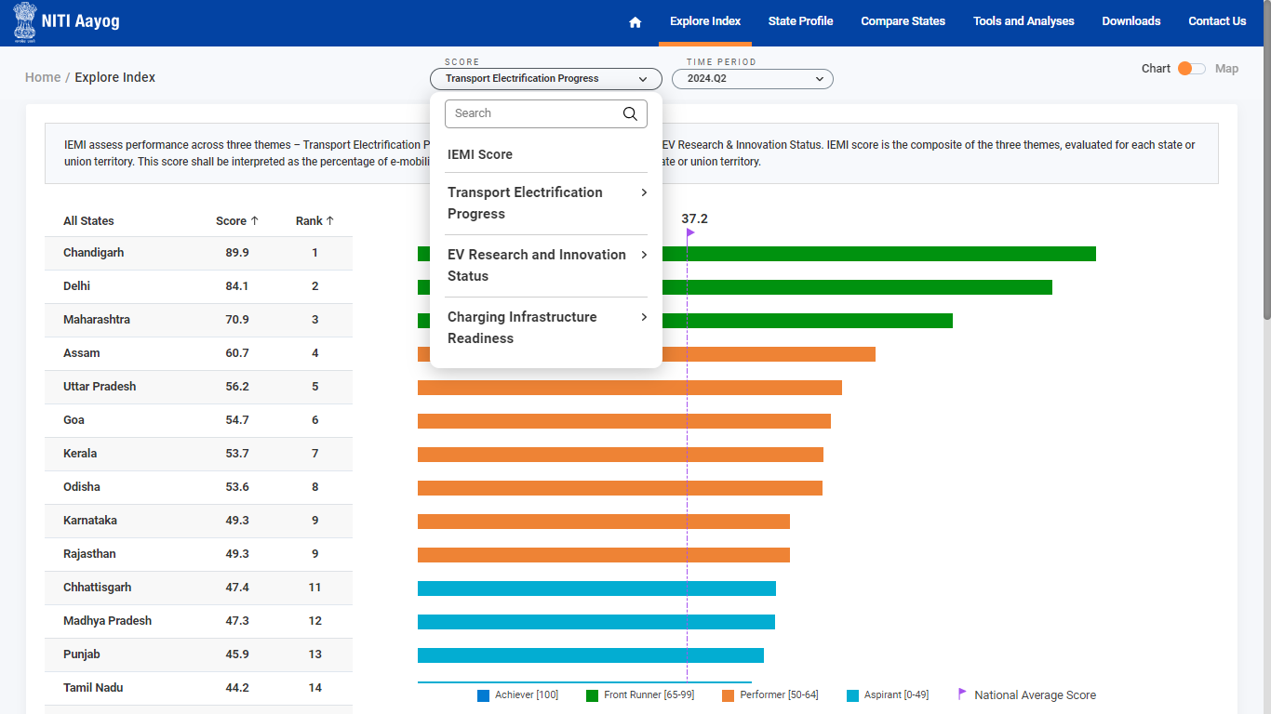
EXPLORE INDEX
Select IEMI Score/Theme/Indicators and Time period to view the respective data

Slide 11
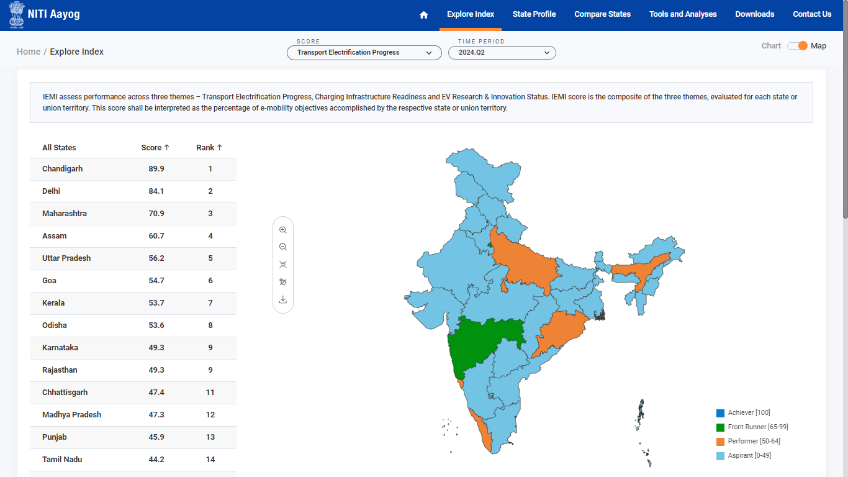
EXPLORE INDEX
Click the toggle button to switch between the chart and the map view.

Slide 12
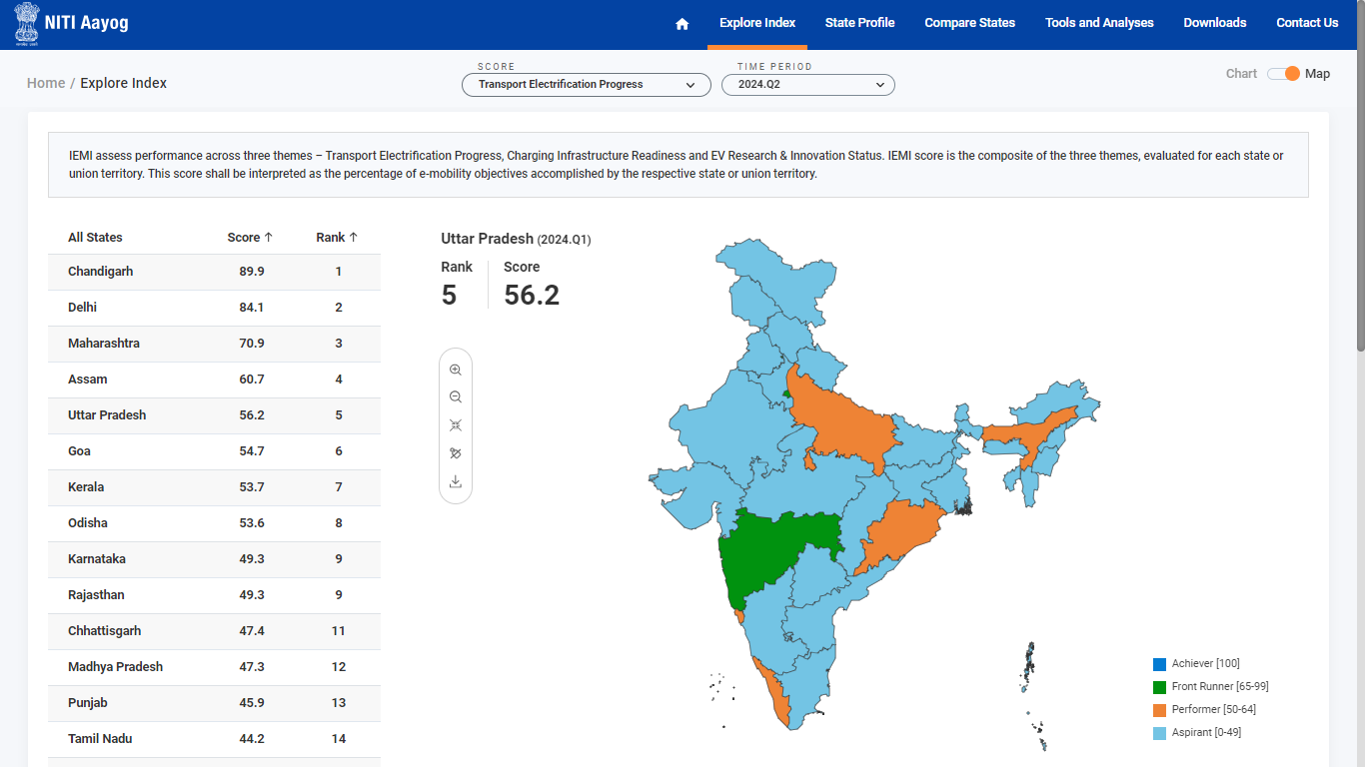
EXPLORE INDEX
Hover on the map to view the Rank and Score of the respective state

Slide 13
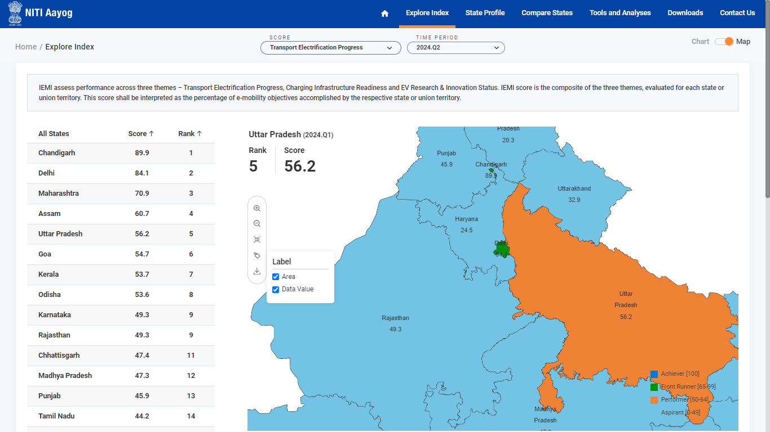
EXPLORE INDEX MAP
Zoom in, Zoom out, Reset, Label on/off, Download

Slide 14
EXPLORE INDEX
Click on the required state to navigate to the respective State Profile

Slide 15
3
State Profile

Slide 16
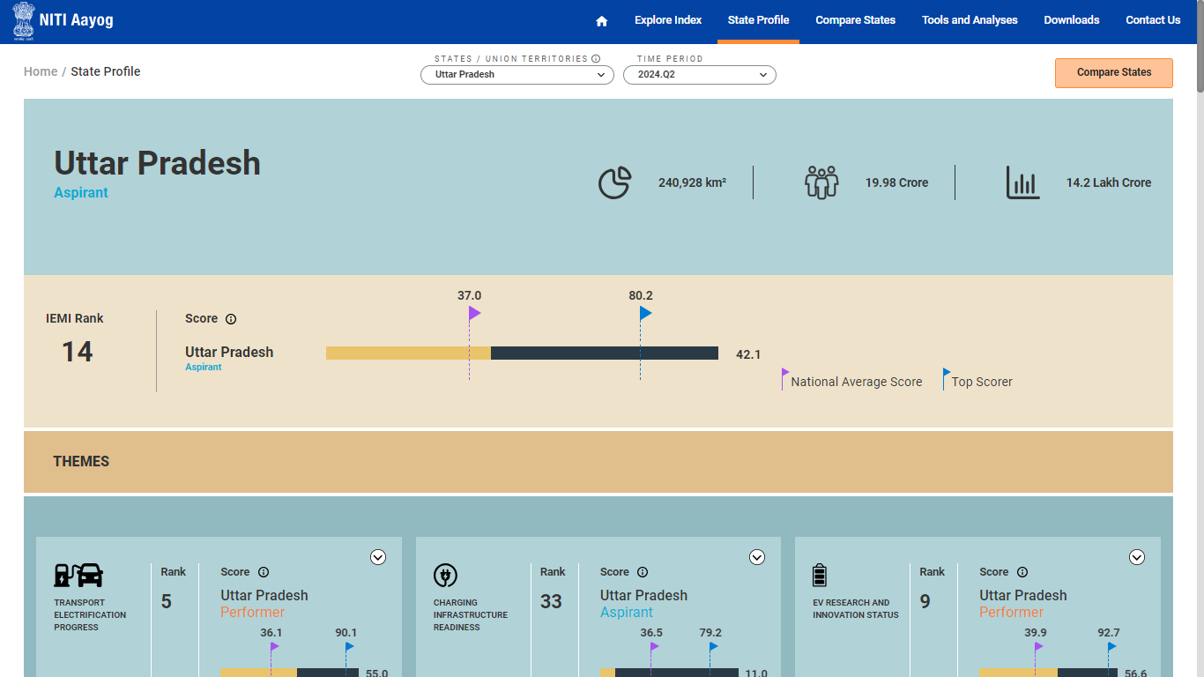
STATE PROFILE
View the state profile of the selected state and time period

Slide 17
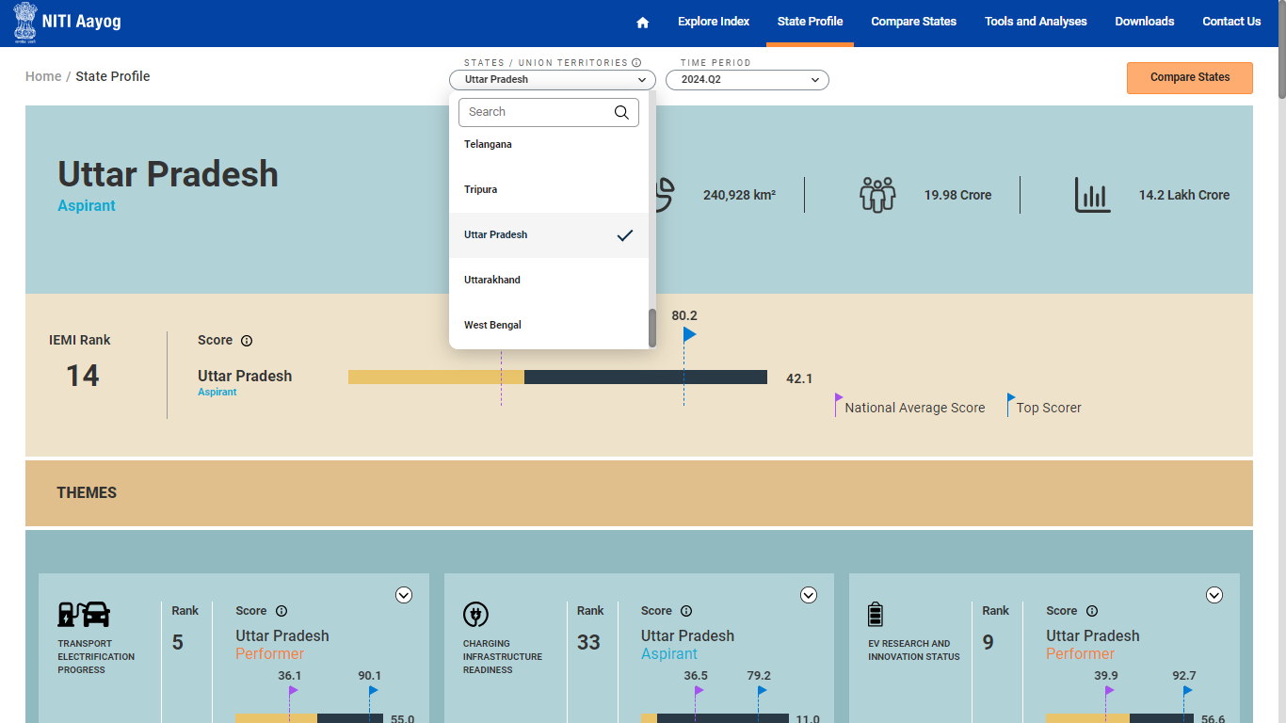
STATE PROFILE
Click on the State/Union Territories and Time period dropdown to select the required parameter

Slide 18
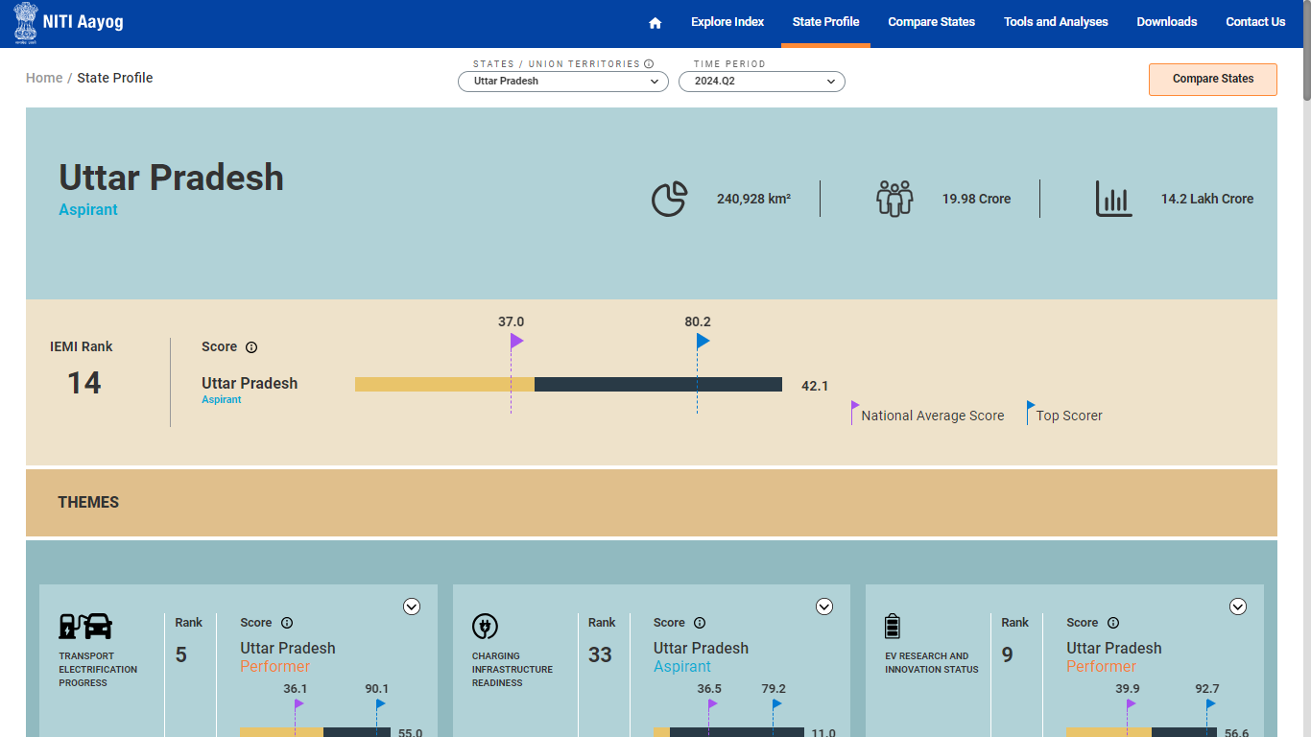
STATE PROFILE
View the IEMI Rank, National Average score and Top scorer details

Slide 19
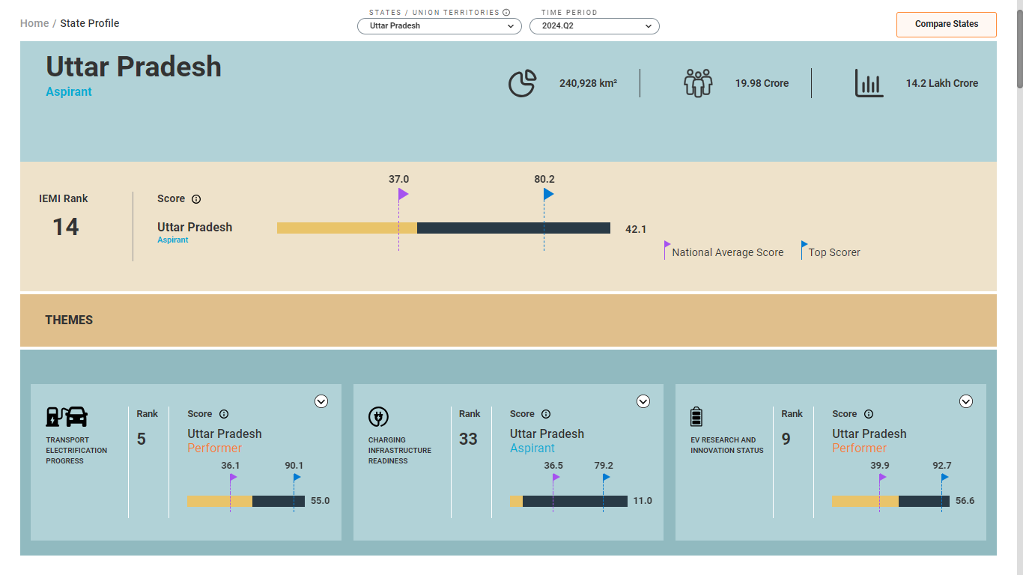
STATE PROFILE
View the Theme wise summarized data of the selected state for the selected time period

Slide 20
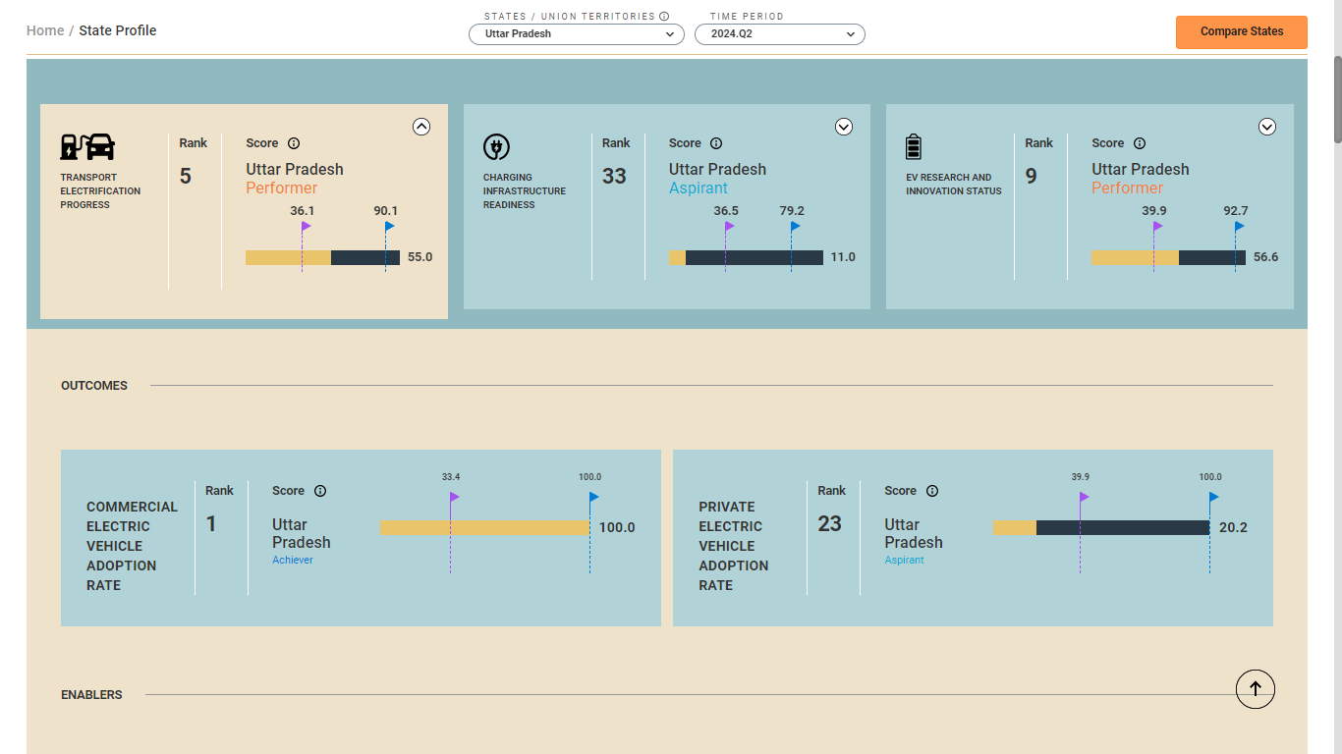
STATE PROFILE
Click on the arrow button to expand the selected theme and view the detailed data of the selected theme

Slide 21
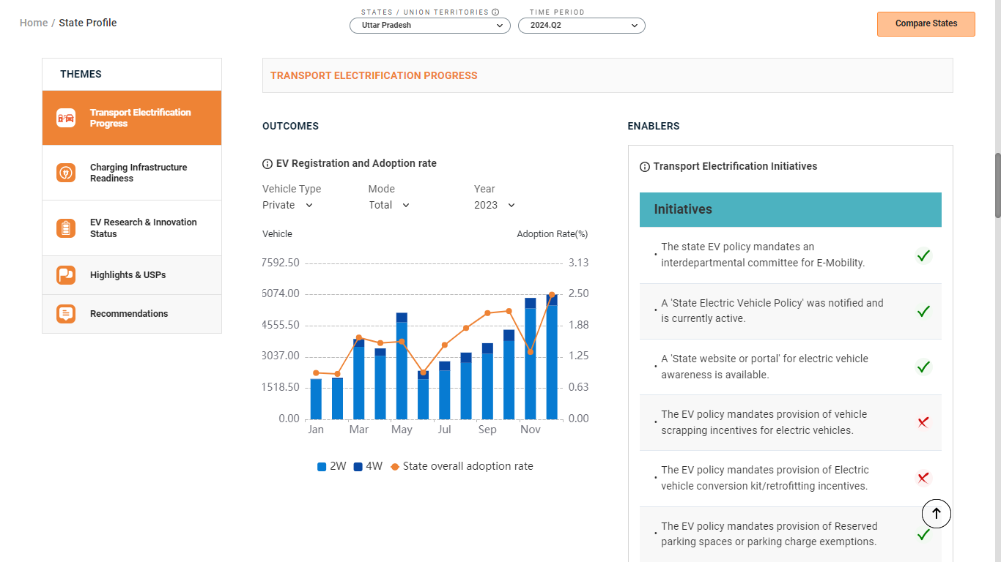
STATE PROFILE
Scroll down to view the complete state profile and related data by themes

Slide 22
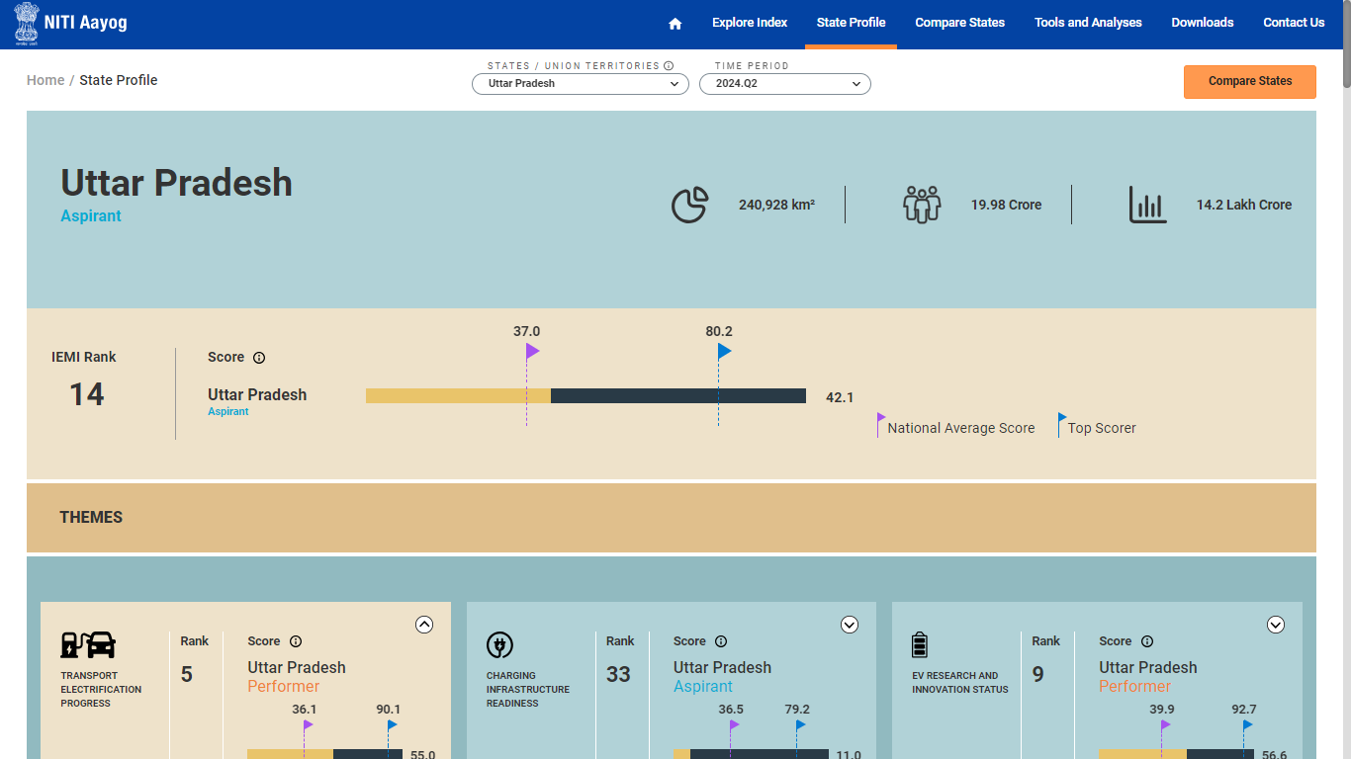
STATE PROFILE
Click on the "Compare States" button to navigate to the “Compare States” module and view the comparison data of the selected states

Slide 23
4
Compare States

Slide 24
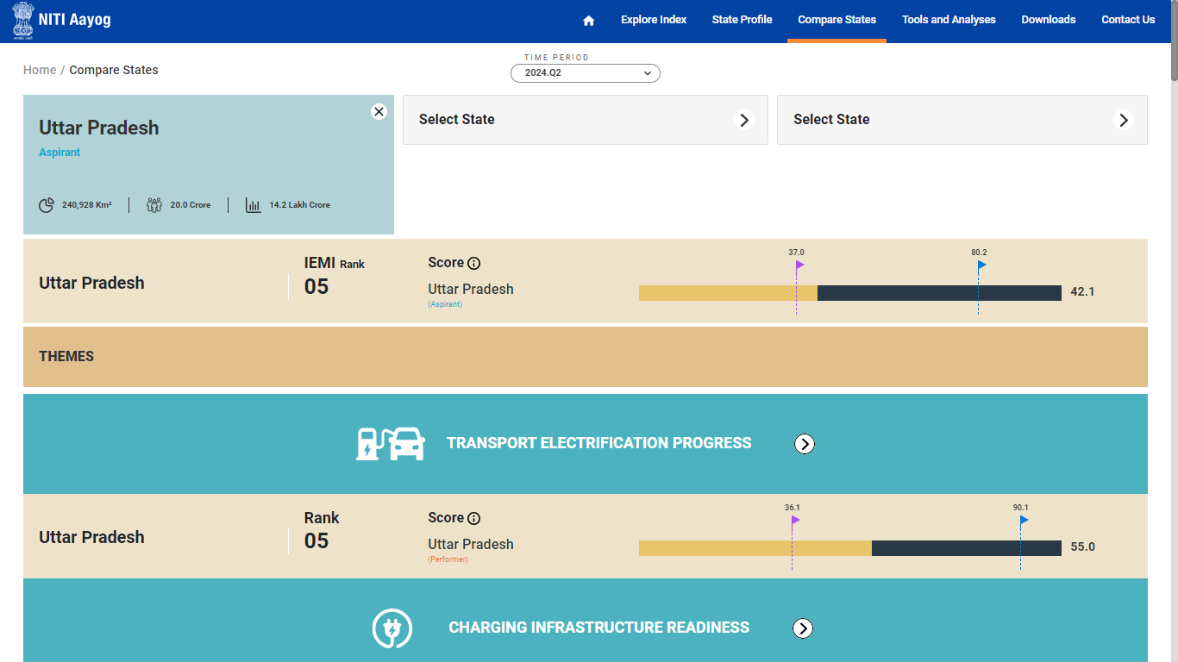
STATE PROFILE
Select the other states to view the comparison data

Slide 25
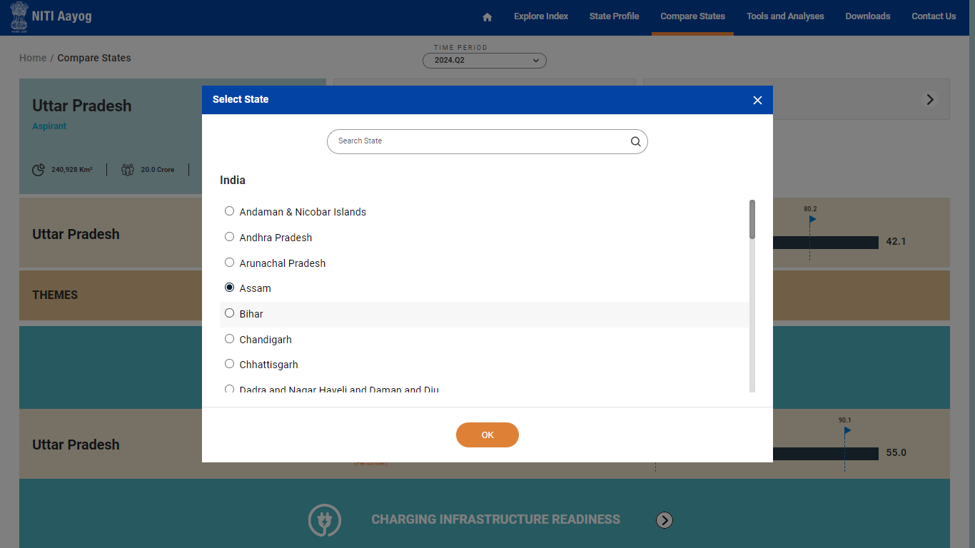
STATE PROFILE
Select the required state from the available list and click on the OK button to confirm

Slide 26
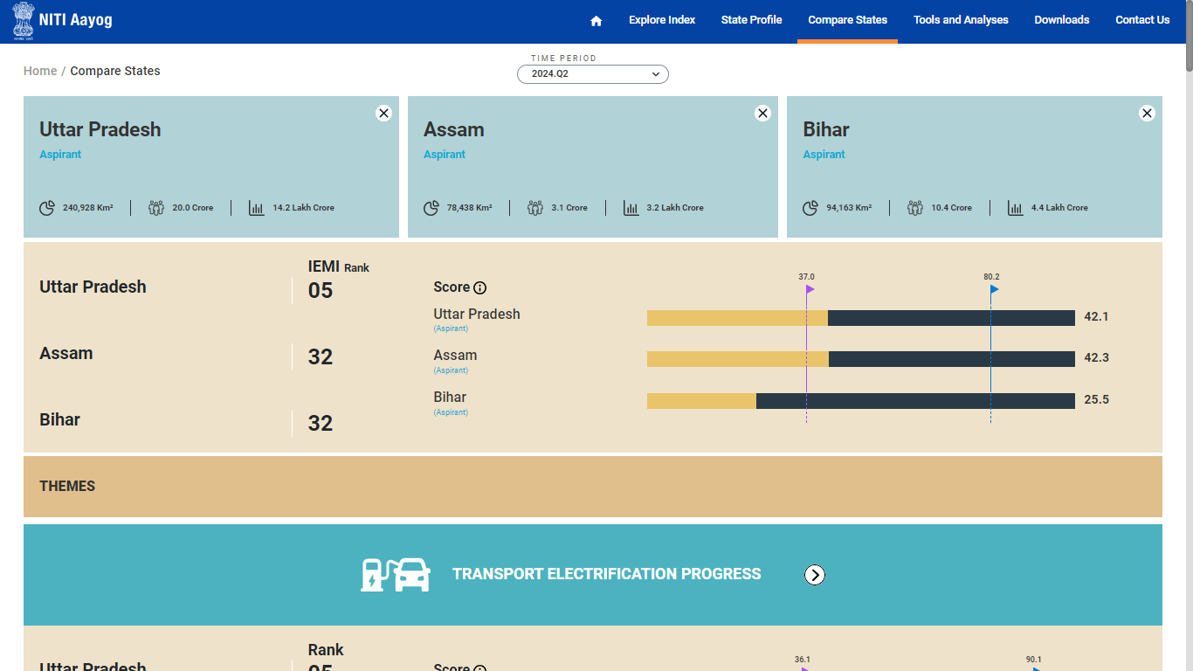
STATE PROFILE
View the comparison data of the selected states

Slide 27
STATE PROFILE
Click on the cross button to remove the selected state

Slide 28
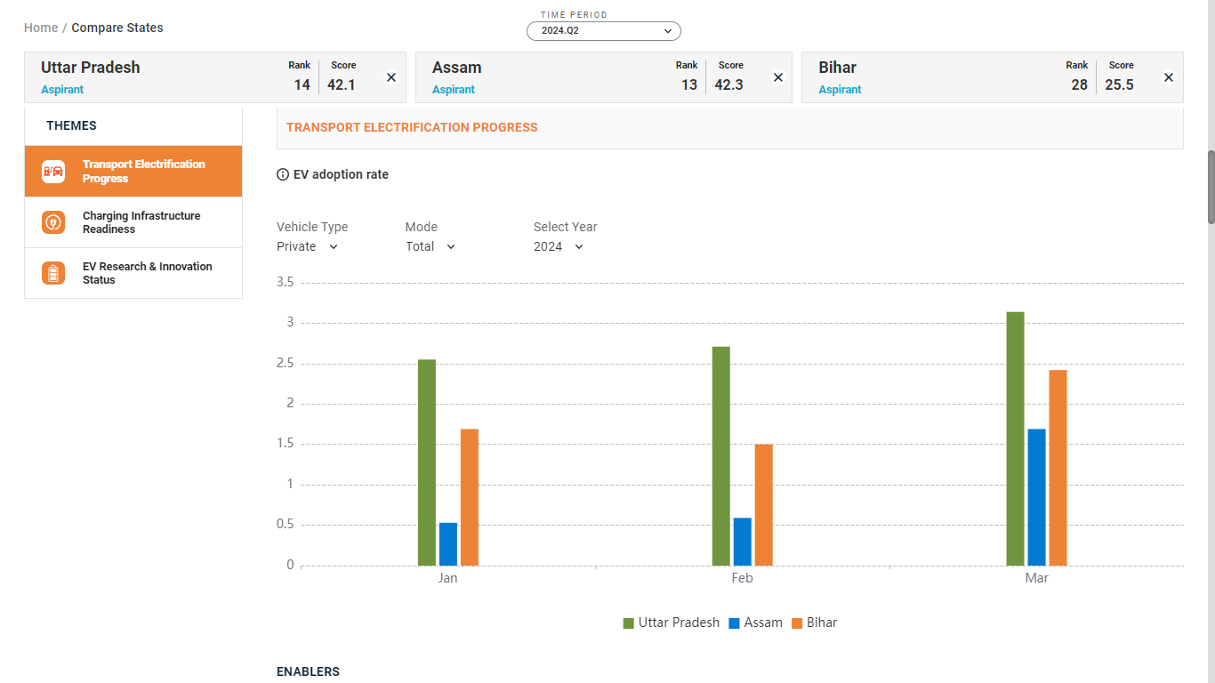
COMPARE STATES
Scroll down and view the comparison data of the selected states by theme

Slide 29
5
Tools and Analyses

Slide 30
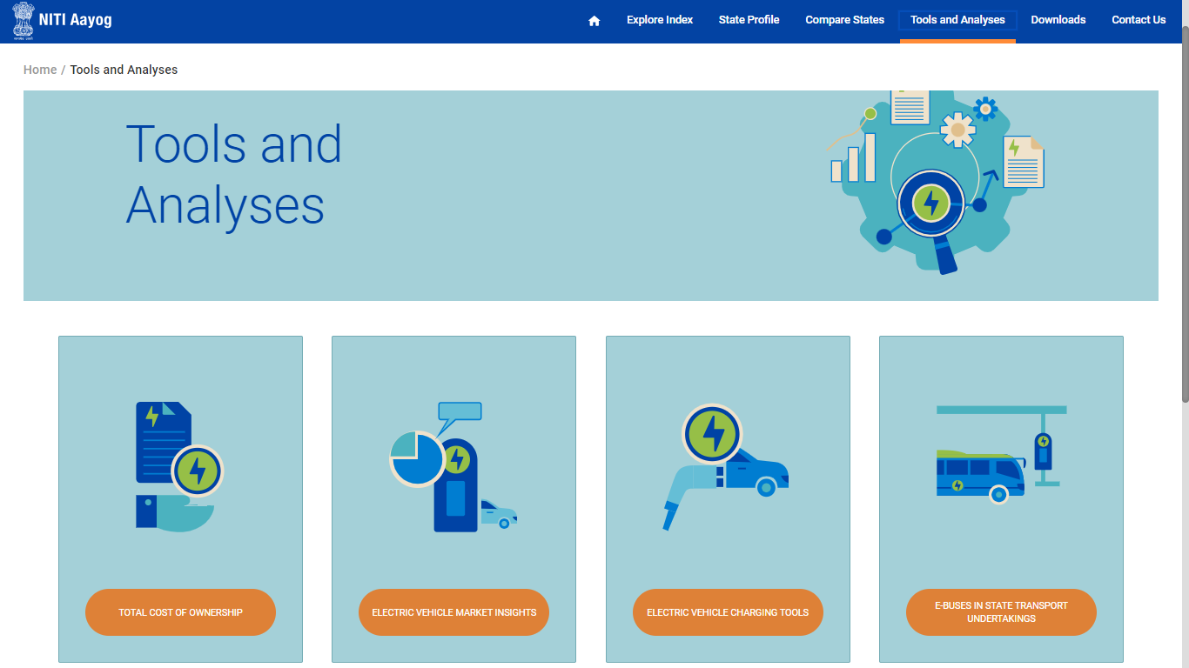
TOOL AND ANALYSIS
Click on the Tools and Analyses option from the navigation menu to navigate to this module

Slide 31
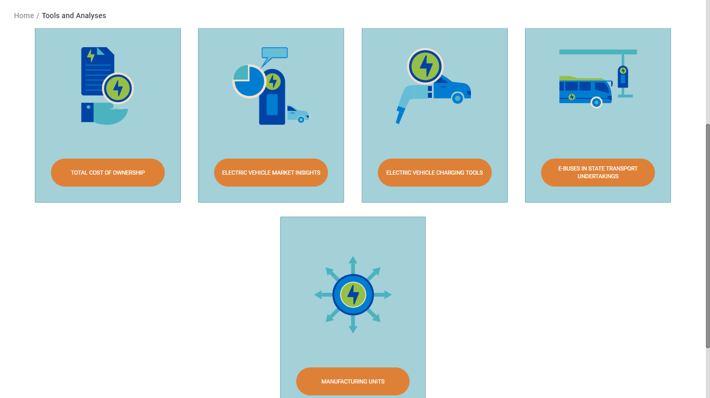
TOOL AND ANALYSIS
Click on the one of the boxes to view the detailed information

Slide 32
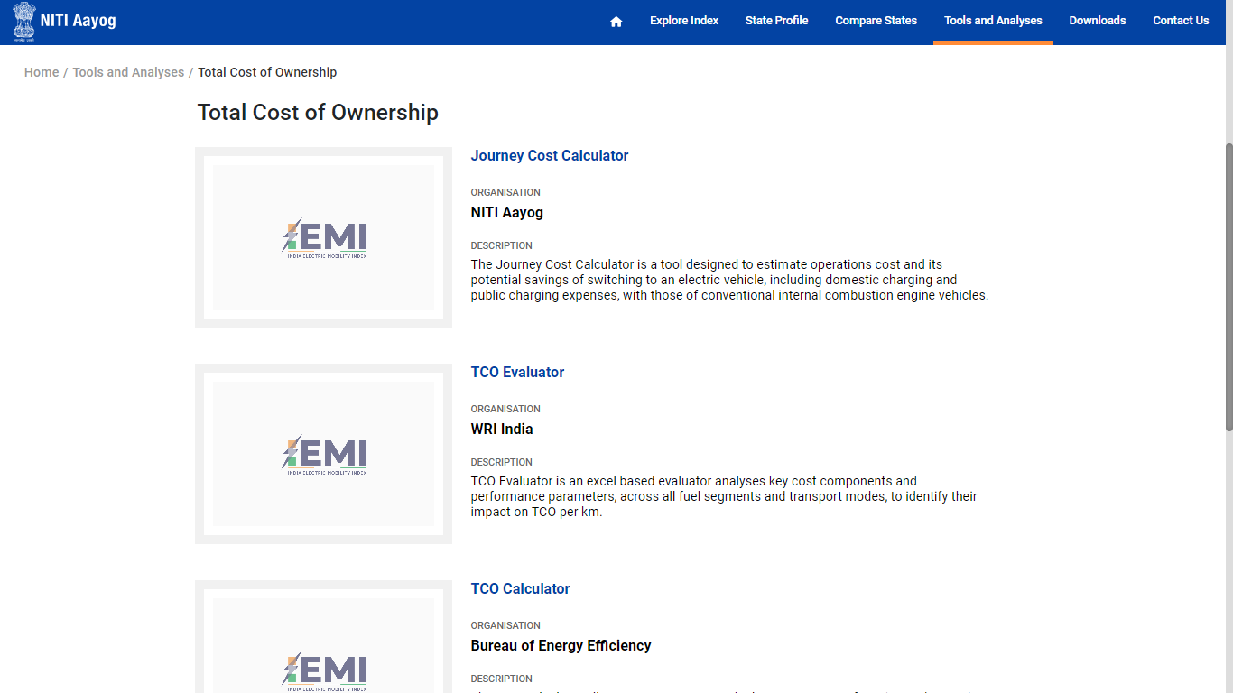
TOOL AND ANALYSIS
View the related information and respurces of the selected category

Slide 33
TOOL AND ANALYSIS
Click on the “Manufacturing Units” box to view the respective data on the National Map

Slide 34
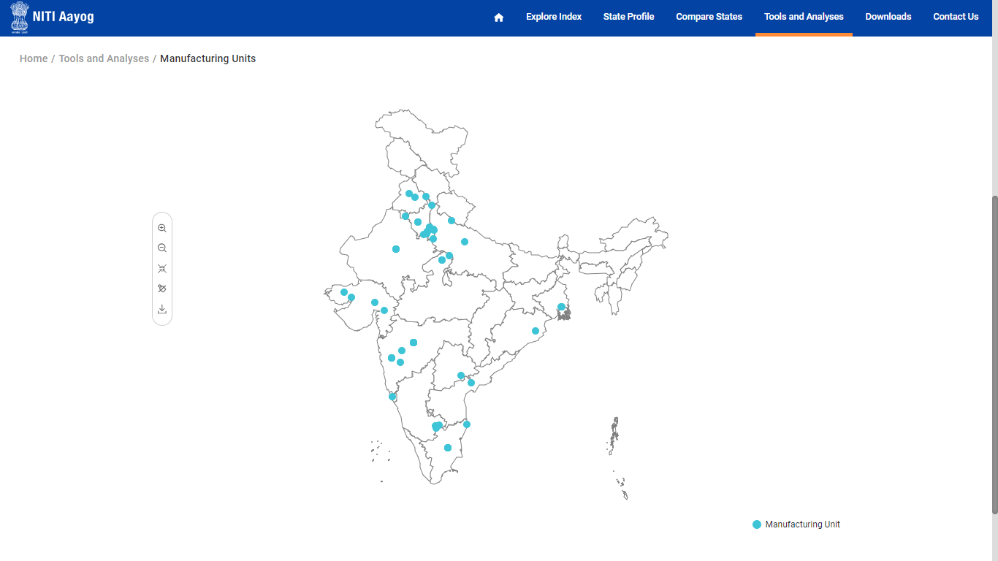
TOOL AND ANALYSIS
View the locations where the manufacturing units are available denoted by dots on the map

Slide 35
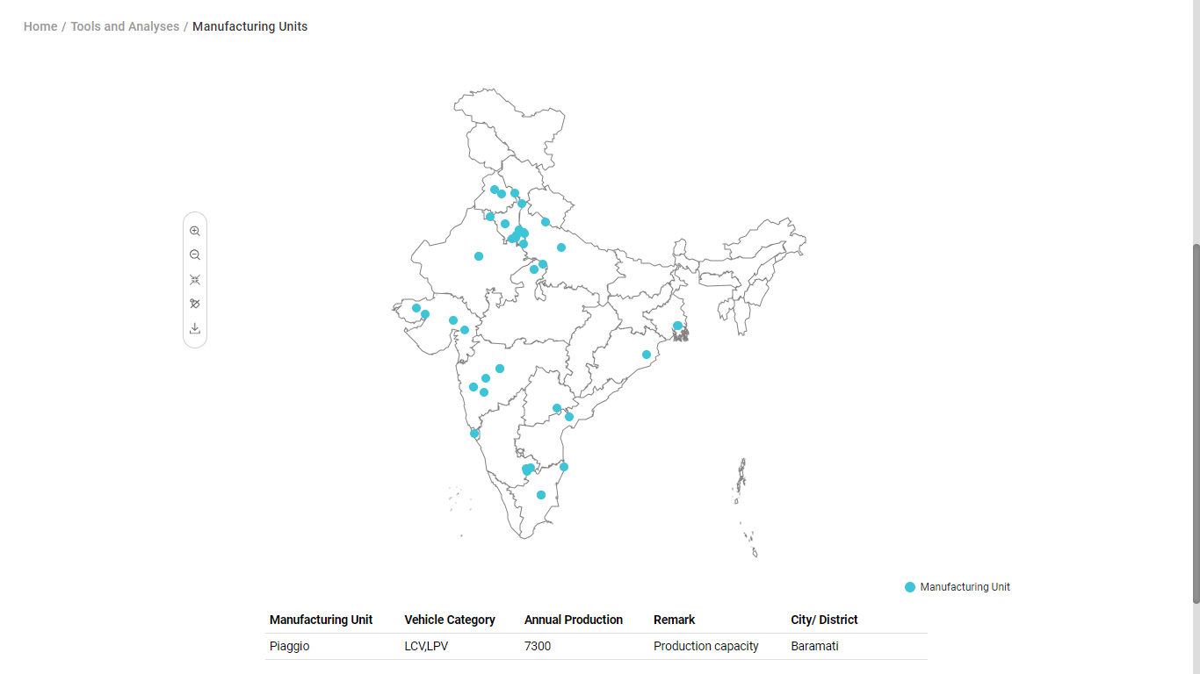
TOOL AND ANALYSIS
Click on the dot to view the additional details of the selected manufacturing unit

Slide 36
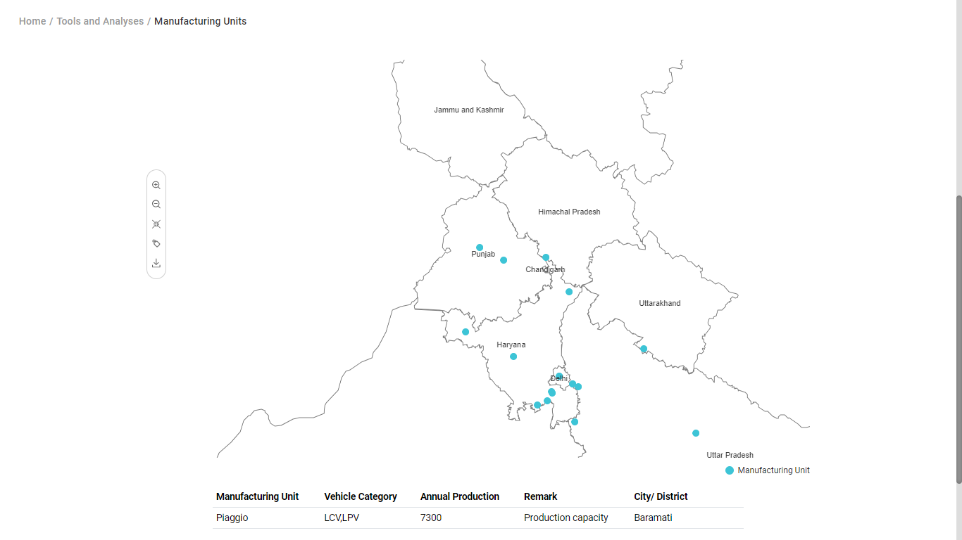
TOOL AND ANALYSIS
Zoom in, Zoom out, Reset, Label on/off and Download

Slide 37
7
Downloads

Slide 38
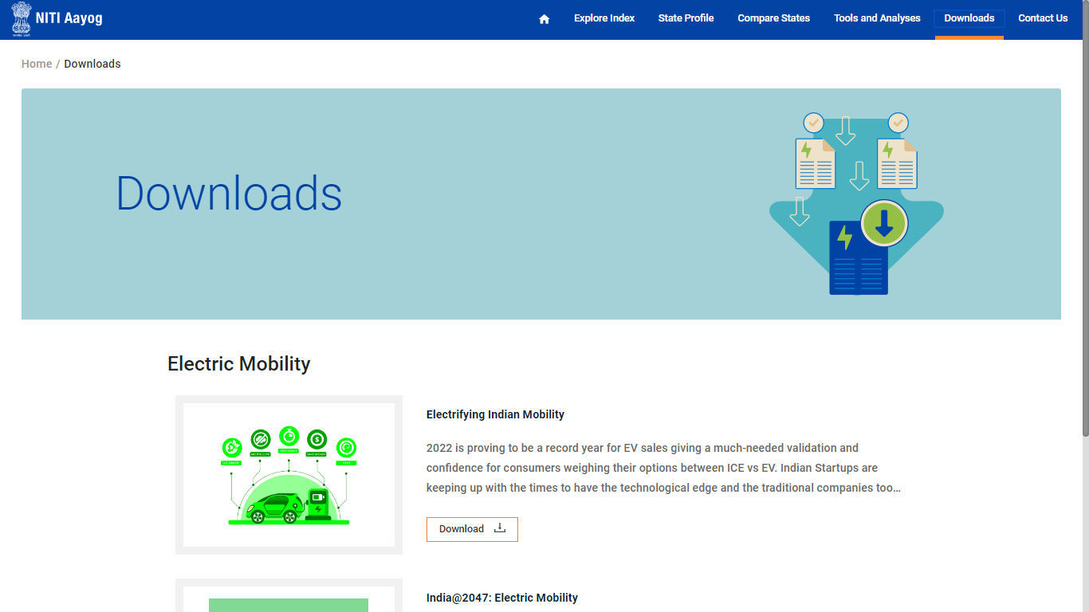
DOWNLOADS
Click on the “Download” option from the navigation menu to navigate to the respective module

Slide 39
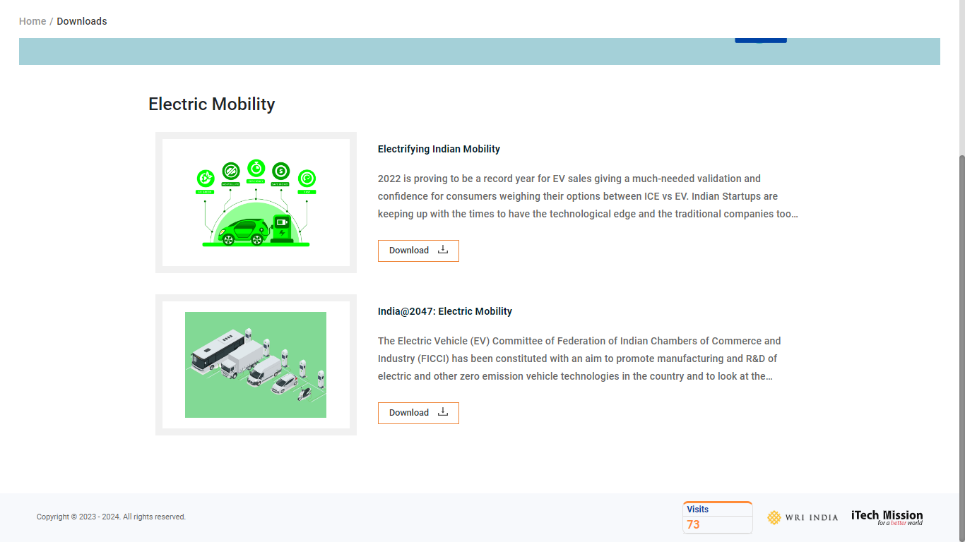
DOWNLOADS
View the list of available resources and click on the download button to download the attached document

Slide 40
8
Contact Us

Slide 41
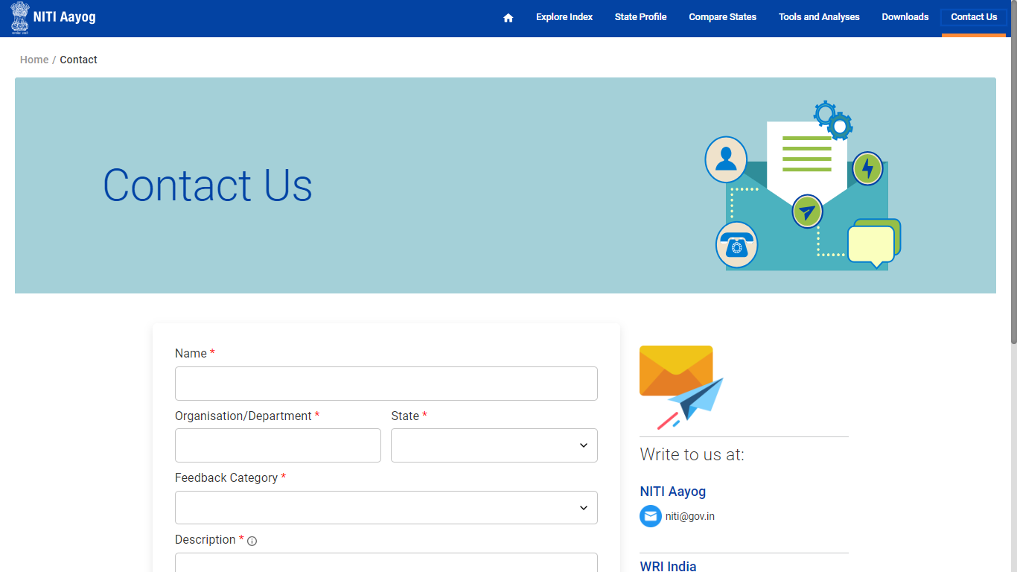
CONTACT US
Click on the “Contact Us” option from the navigation menu to navigate to the respective module

Slide 42
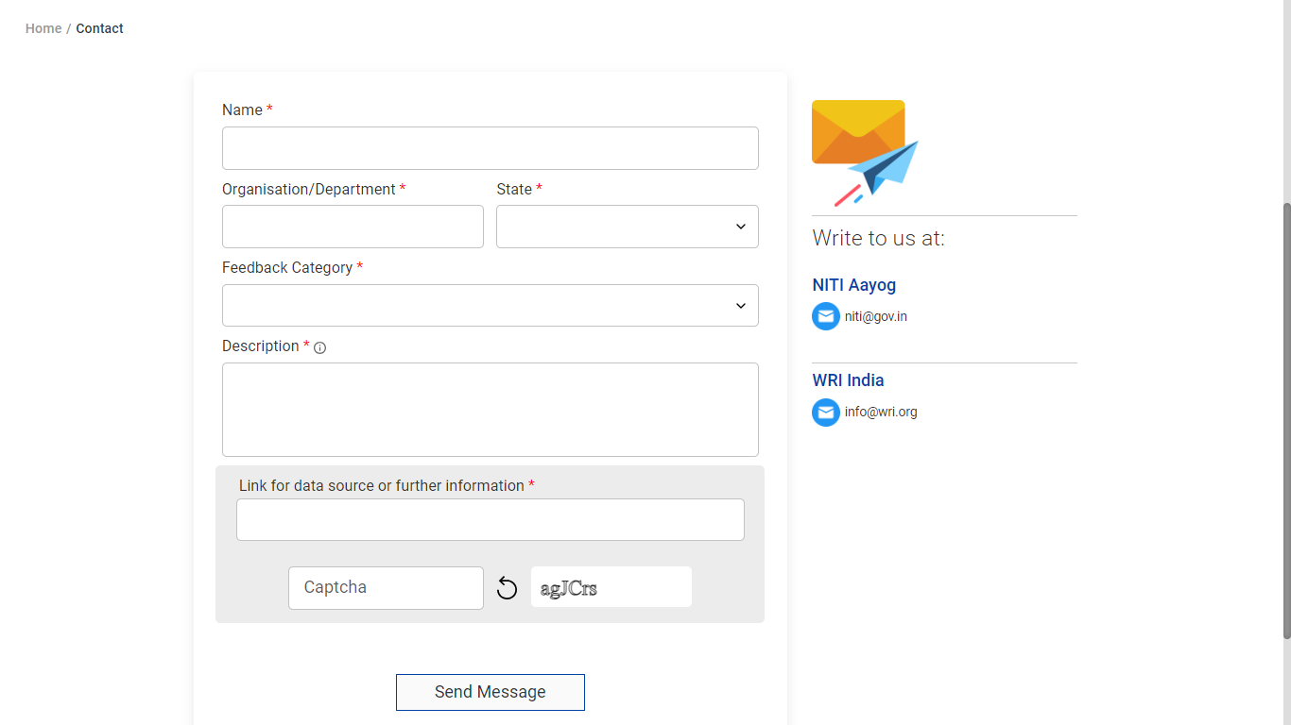
CONTACT US
Fill the required details and click on send message to send enquiry message or mail on the given details.

Slide 43


